Slide 1

Java Chain
Your Coffee Chain On the Block

Slide 2




Meet the Team
Andrew Smith-Mui
Eric Baran
Andrew Rubi
Bryan Castillo

Slide 3

Mission statement:
To increase the amount of auditability, trust, and reliability in company accounting records using a secure blockchain solution

Slide 4
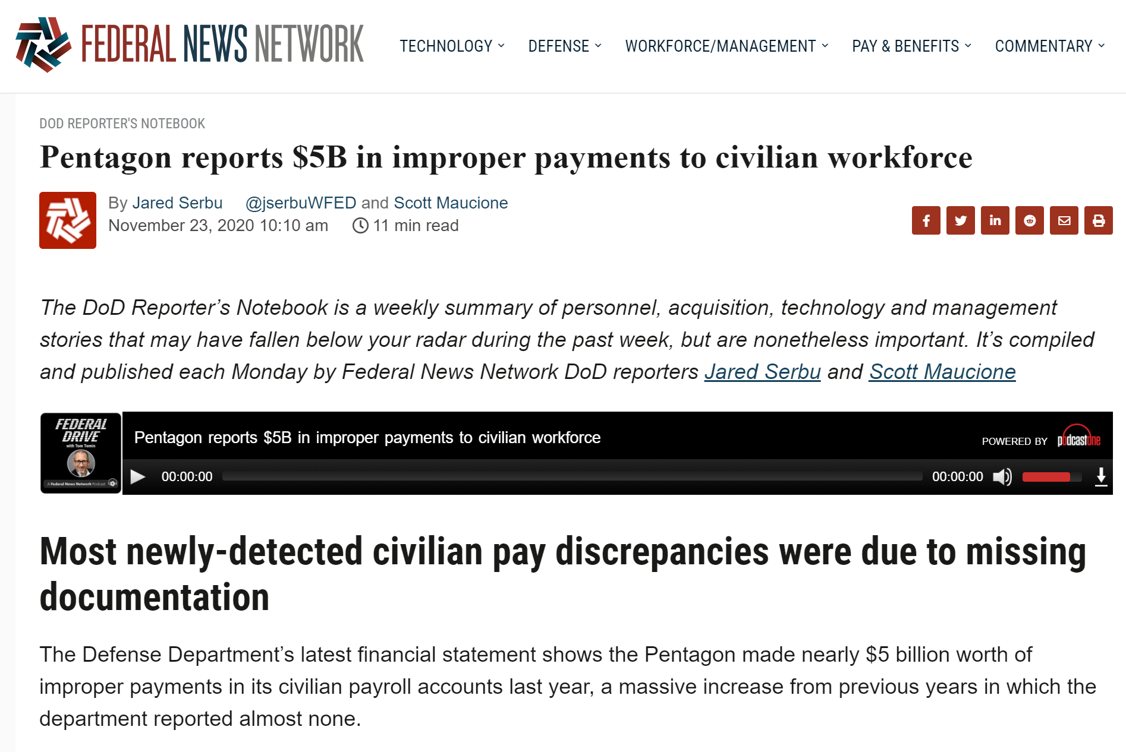
The problem
Managing cash-flow, expenses, payroll, and tax documents are challenging, especially for a small business.
Difficult to maintain transparency and accuracy for small business accounting records
Source: https://federalnewsnetwork.com/
Could a smart contract architecture have prevented this?

Slide 5

The solution
Use a secure blockchain to perform transactions to increase the auditability, trust, and reliability of our small business accounting records

Slide 6



Milestones
Java Chain development process 21 Nov - 8 Dec 2020
Project Day 1
Project Day 3
Project Day 5
Project Day 2
Project Day 4
JavaChain
Presentation
-Developed project idea & mission statement
-Used JavaScript for front-end site & MetaMask integration
-Finalized presentation & Java Chain site
NOV | DEC
-Began smart contract draft in Remix
-Integrated Truffle suite to run multiple smart contracts

Slide 7
How it works
Step 3
Step 2
Step 1
Verify activity on the blockchain
Record accounting transactions
Deploy contract on secure blockchain

Slide 8

The technology:
Solidity Smart Contracts on the Blockchain

Slide 9

Why now?
Blockchain technology has the potential to further revolutionize the accounting industry by enhancing productivity, accuracy, data security, reducing maintenance expenses and reconciling ledgers.
Organizations can record their transactions right into a decentralized ledger, forming an interlocking arrangement of abiding accounts and records.

Slide 10
Blockchain Accounting
Software
Built-in Auditing
Reduced Fraud
Reduced Errors
Enhanced Regulatory Compliance
Enhanced Efficiency
Easier Reconciliation
Manage Ledger
Superior Transparency
Reliable Solutions
Quick Transactions
More Security
Wallet Transactions

Slide 11
Future considerations for project expansion:
-Smart contract to interact with applicable tax policy and documentation
-Expand transaction contract to integrate real time transactions (customer purchases)
-Expanded transaction contract to accept wide variety of cryptocurrencies
-Expanded inventory management contract to output resupply notifications & integrated order/shipment tracking

